Slide 1


Slide 2
Surprise Housing - Housing Price Predication & Analysis Project
Submitted By
Mrs. Swati Amit Motugade
Internship 31

Slide 3
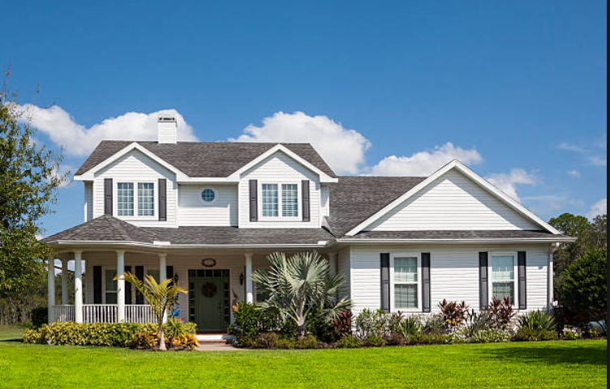

Slide 4
Introduction to Housing Price Prediction
Houses are one of the necessary needs of each and every person around the globe and therefore housing and real estate market is one of the markets which is one of the major contributors in the world’s economy. It is a very large market and there are various companies working in the domain. Data science comes as a very important tool to solve problems in the domain to help the companies increase their overall revenue, profits, improving their marketing strategies and focusing on changing trends in house sales and purchases.
In general, purchasing and investing in any real estate project will involve various transactions between different parties. Thus, it could be a vital decision for both households and enterprises. How to construct a realistic model to precisely predict the price of real estate has been a challenging topic with great potential for further research.
There are many factors that have an impact on house prices, such as the number of bedrooms and bathrooms. House price depends upon its location as well. A house with great accessibility to highways, schools, malls, employment opportunities, would have a greater price as compared to a house with no such accessibility.

Slide 5
Problem Statement
A US-based housing company named Surprise Housing has decided to enter the Australian market. The company uses data analytics to purchase houses at a price below their actual values and flip them at a higher price. For the same purpose, the company has collected a data set from the sale of houses in Australia. The data is provided in the CSV file . The company is looking at prospective properties to buy houses to enter the market.
We are required to build a Regression model using Machine Learning in order to predict the actual value of the prospective properties and decide whether to invest in them or not.
The Company wants to know
1. Which variables are important to predict the price of variable?
2. How do these variables describe the price of the house?

Slide 6
Objective
Our main objective of doing this project is to build a model to predict the house prices with the help of other supporting features.
To construct a realistic model to precisely predict the price of real estate has been a challenging topic with great potential for further research.

Slide 7
Conceptual Background
There are many factors that have an impact on house prices, such as the number of bedrooms and bathrooms. House price depends upon its location as well. A house with great accessibility to highways, schools, malls, employment opportunities, would have a greater price as compared to a house with no such accessibility.
The No Free Lunch Theorem state that algorithms perform differently when they are used under the same circumstances.
The study answers the following research questions:
- Research question 1: Which machine learning algorithm performs better and has the most accurate result in house price prediction? And why?
- Research question 2: What are the factors that have affected house prices in Australia over the years?

Slide 8
Data Sources and their formats
Data set provided by Flip Robo was in the format of CSV (Comma Separated Values). There are 2 data sets that are given. One is training data and one is testing data.
Train file will be used for training the model, i.e., the model will learn from this file. The dimension of data is 1168 rows and 81 columns.
Test file contains all the independent variables, but not the target variable. The dimension of data is 292 rows and 80 columns.

Slide 9
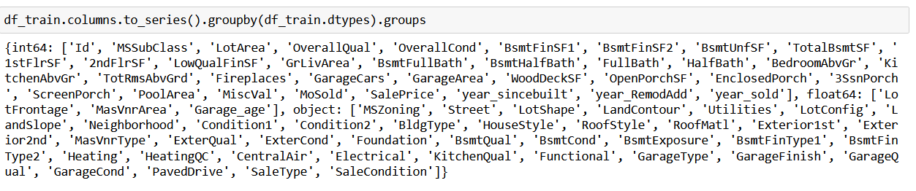
Followings are the different variables of the dataset

Slide 10
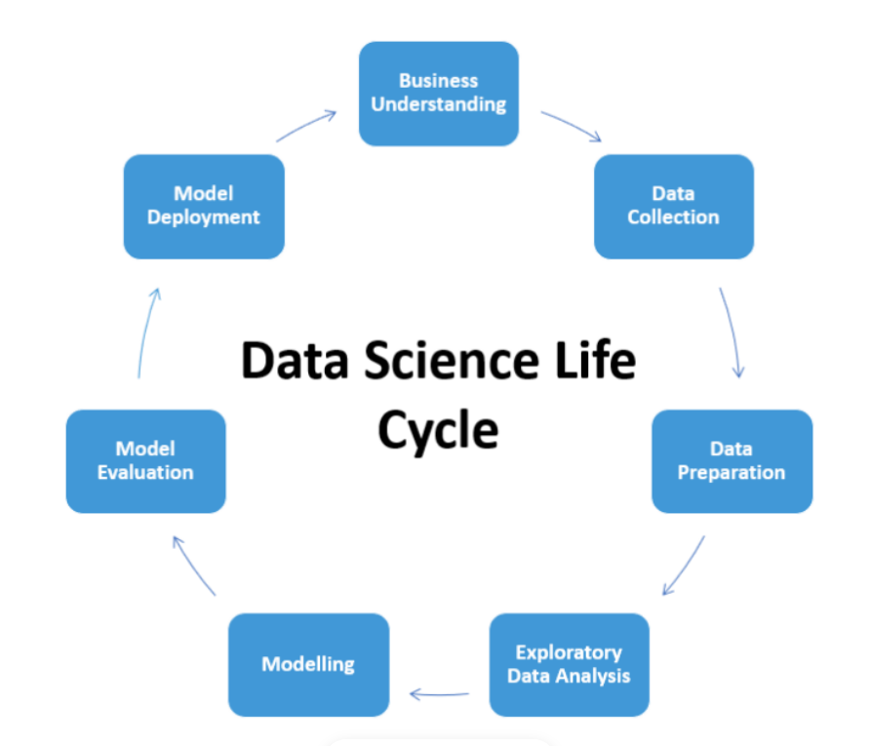
Project Cycle

Slide 11
Tasks Performed
Loaded both training & test datasets provided by FlipRobo.
Checked data integrity for duplicate entries and other errors.
There were missing values present in some features. Dropped the features containing more than 40% missing values.
For the remaining features with missing values, imputation is performed with mean, median and mode depending upon the feature type.
Feature engineering is performed by extracting some new features out of existing features.
Feature selection is performed by taking only the features which are really required for analysis.
For categorical features Label Encoding is performed.
Splitted the dataset into Target variable and Features.
Used Standard Scaling on dataset.
Performed model training for training dataset.
Saved the final model.
Performed Model deployment .

Slide 12
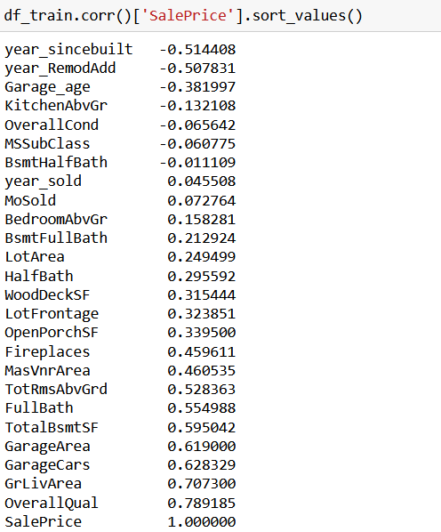
Correlation of Features with Target Variable

Slide 13
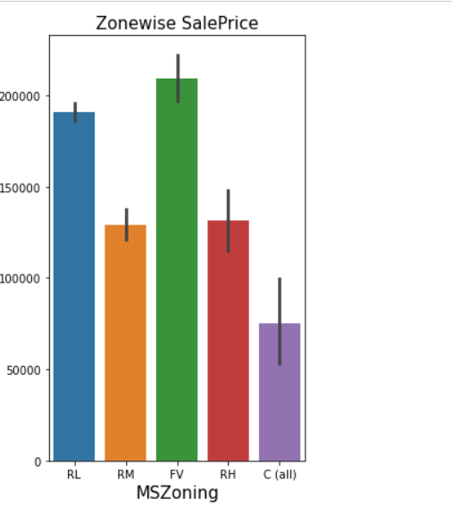
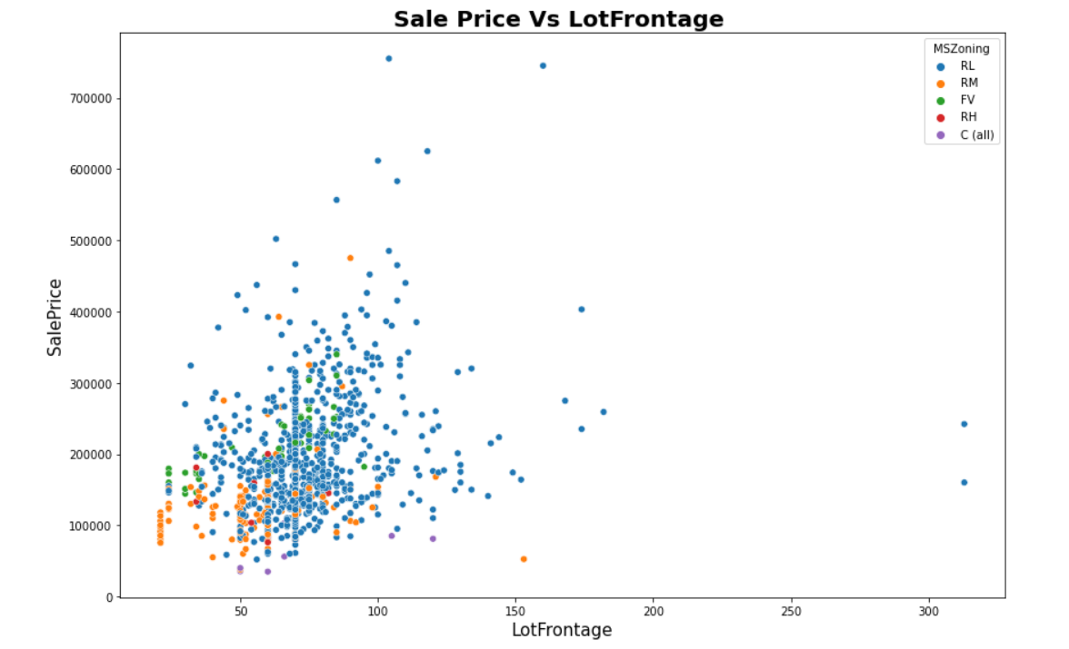
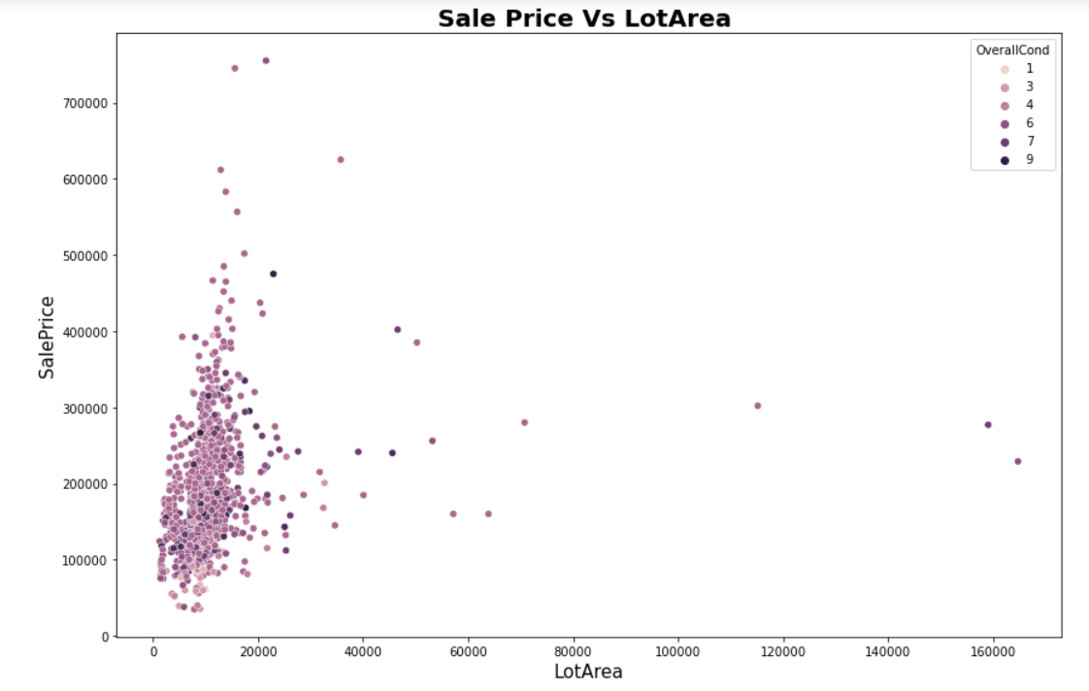
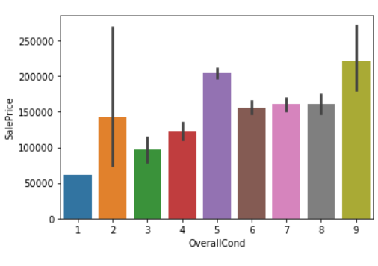
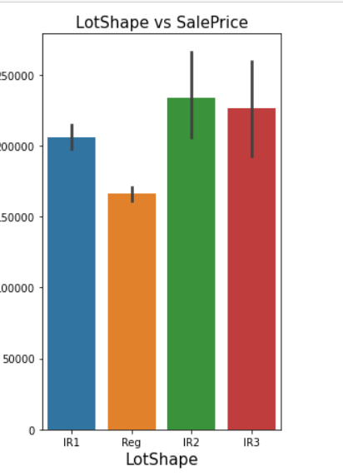
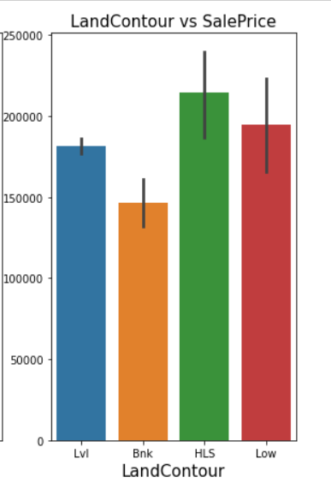
Data Visualization Since there are too many features here I’ve taken only key features to show their effect on Target.

Slide 14
Observations
Highest SalePrice is for Floating Village Residential zone followed by Low Density Residential zone
The Lowest Sale Price is for Commercial zone.
Sale price increases with increase in LotFrontage area except for Commercial zone.
No significant relationship seen between LotArea and SalePrice.
The highest sale price is for overall condition rating 9.
Lowest saleprice is for overall cindition rating 1.
Here we can see that the saleprice is less for overall condition rating 6,7 & 8 as compared with overall condition rating 5 which means that Overall condition rating is not that much affecting feature for SalePrice.
the highest saleprice is for properties with Moderately irregular shape folloed by properties with Irregular shape.
Lowest sale price is for properties with Regular shape.
SalePrice for Hillside Properties are much greater than other LandContour.
Lowest SalePrice is for Banked LandContour properties.

Slide 15
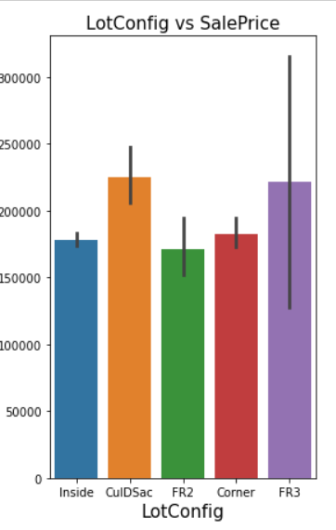
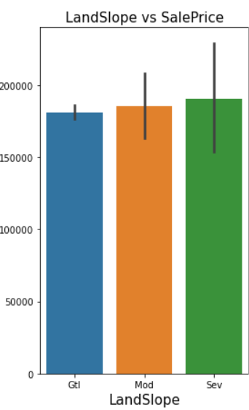
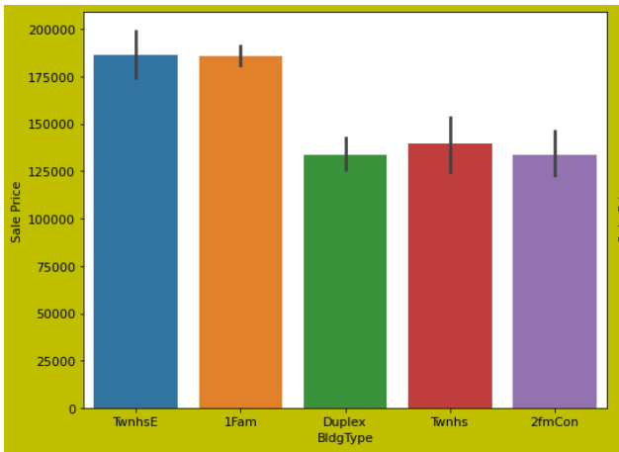
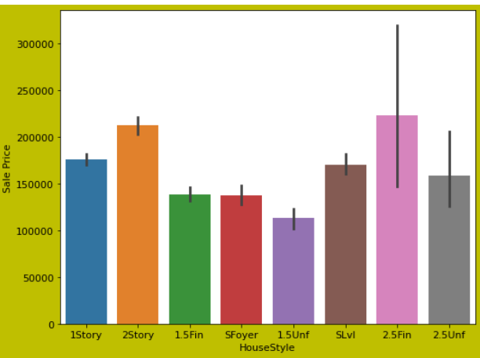
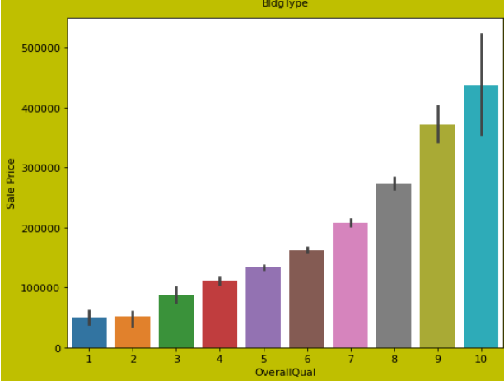
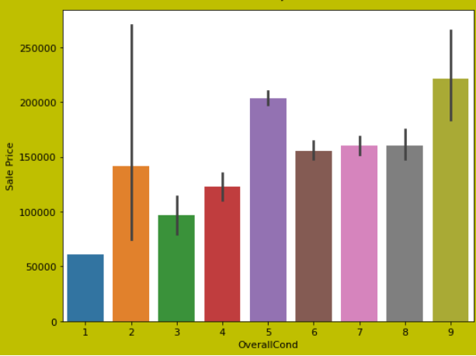

Slide 16
Observations
Properties with CulDSac configuration has maximum selling price followed by properties with FR3 configuration.
FR2 configuration properties has less sale price.
Sale price is maximum for properties of Severe type slope.
Sale price is minimum for properties of Gentle type slope.
Sale price is high for TwnhsE & 1Fam building type.
Sale price is maximum for 2.5Fin House style & minimum for 1.5 Unf type of house style.
As Overall Quality increases the sale price also increase with it.

Slide 17
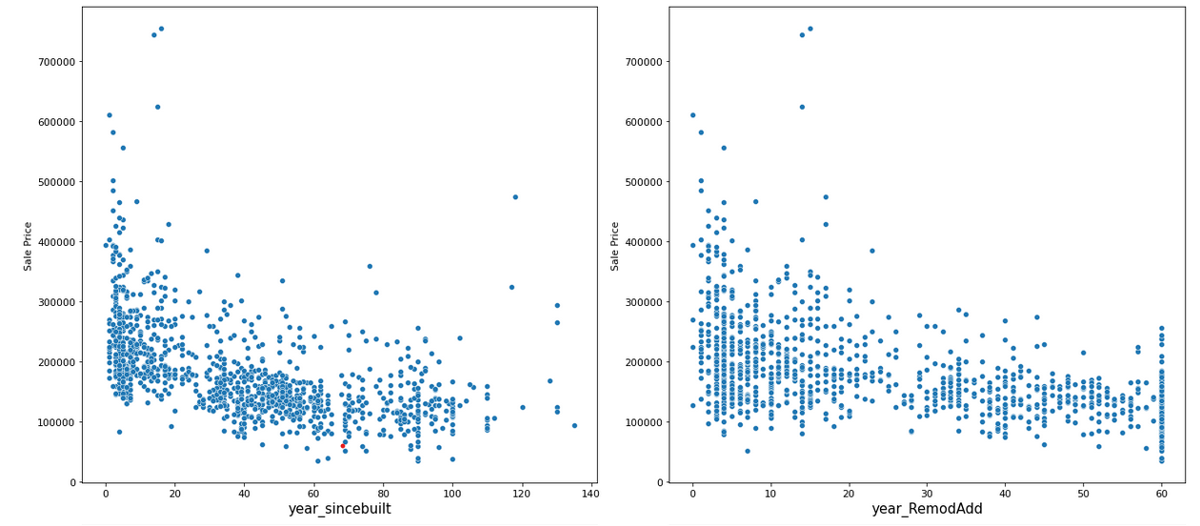
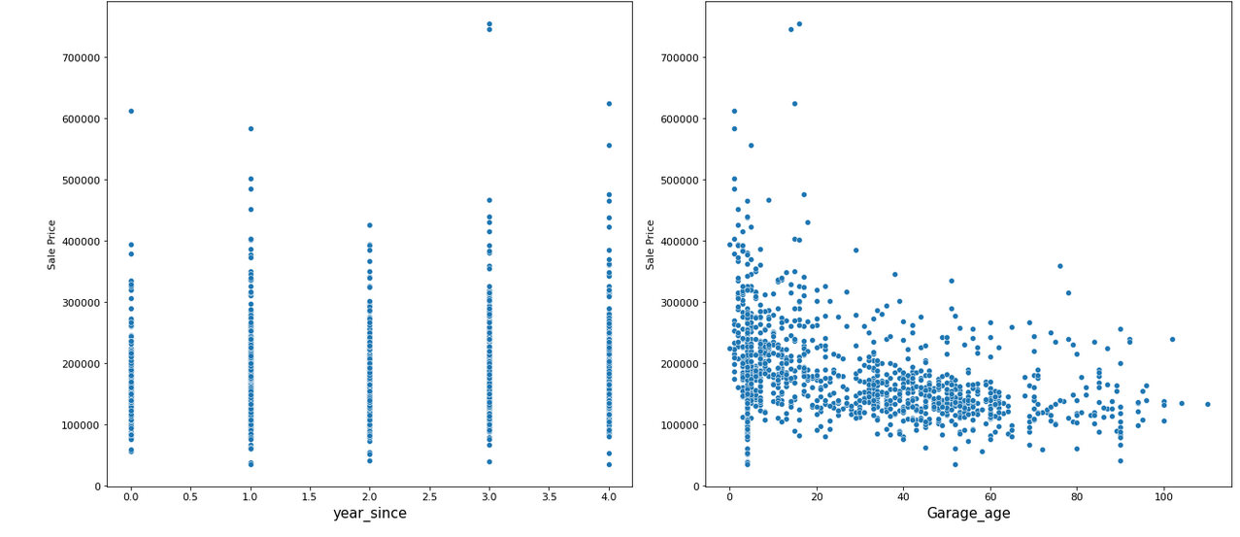

Slide 18
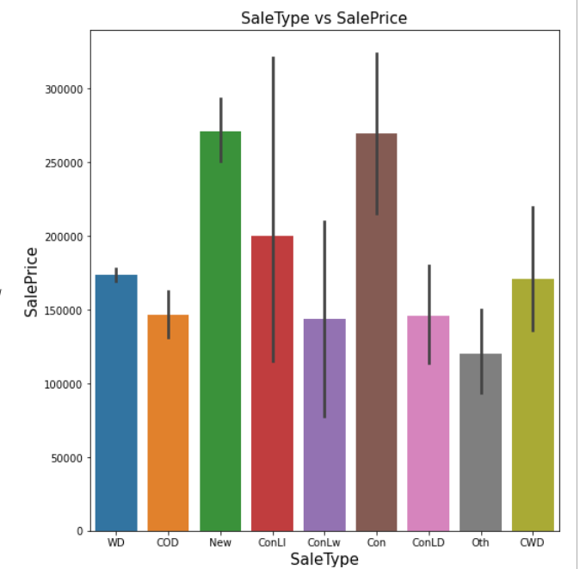
Observations
1. We can see that as Property get older with time its sale Price get depricates.
2. 20 years after Remodelling Price of properties start decreases.
3. Older the garage age less the price of Property.
Sale Type
The Sale prices are more for Homes just constructed
& sold and for Contract 15% Downpayment regular terms.
The sale prices are less for The sale prices are more for
other sale type properties.

Slide 19
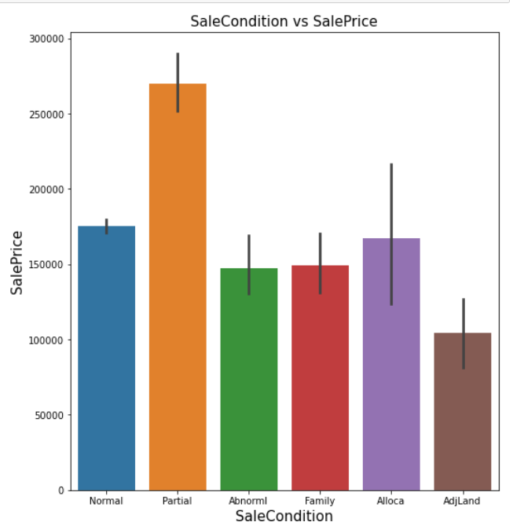
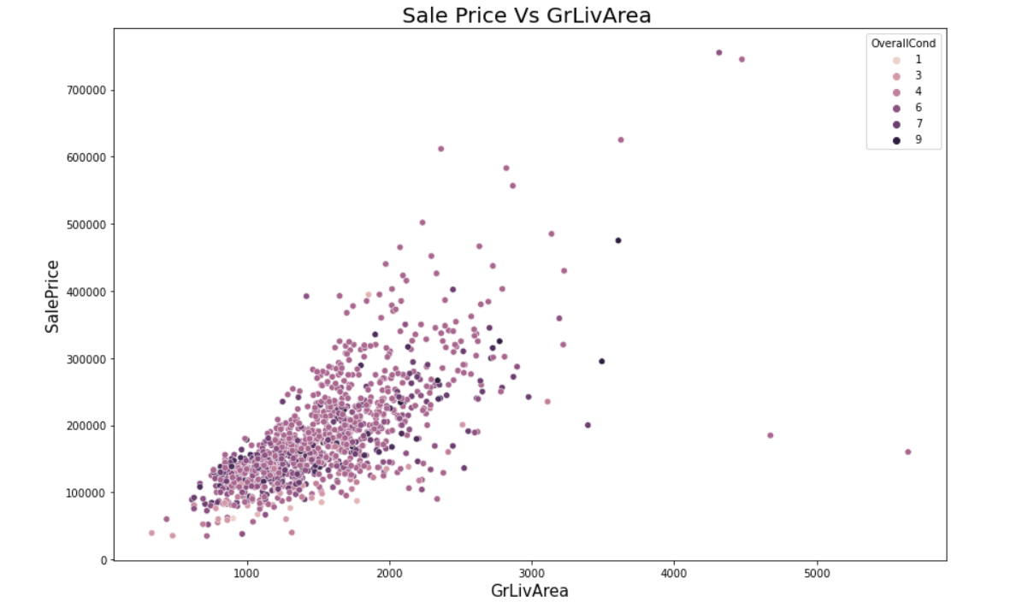
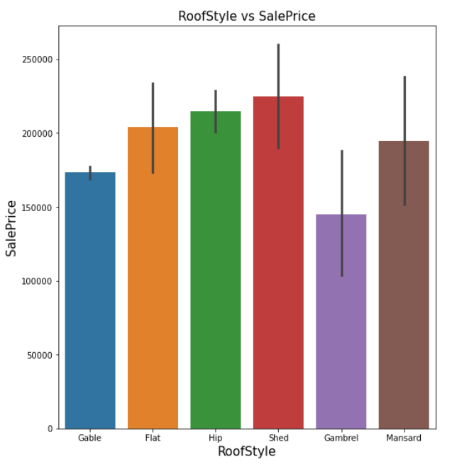
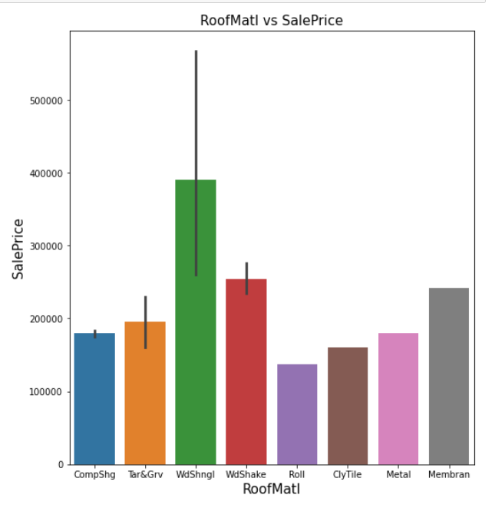
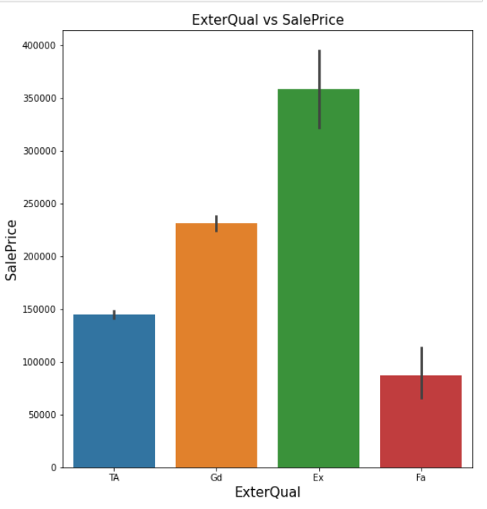
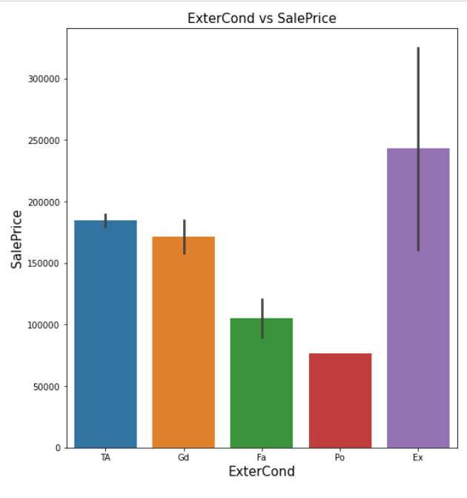

Slide 20
Observations
Highest SalePrice is for Partial sale condition.
Lowest saleprice is for Adjoining Land Purchase sale condition.
The properties with Shed roofstyle are more costly.
The properties with Gambrel roof style are less costly.
Maximum sale price is for properties with Wood Shingles roof material.
Minimum sale price is for properties with Roll roof material.
Minimum sale price is for Fair Exterior quality.
Sale price is High for Excellent Exterior quality.
Sale price is High for Excellent Exterior Condition properties.
Minimum sale price is for Poor Exterior Condition properties.

Slide 21
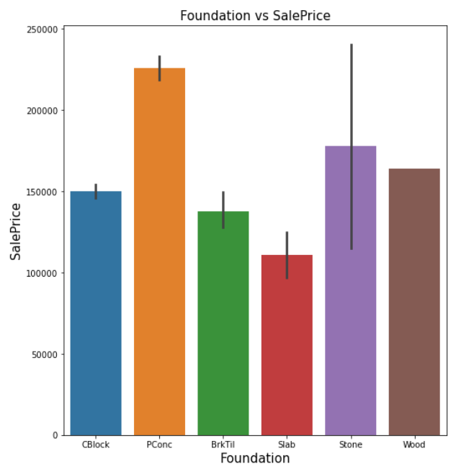
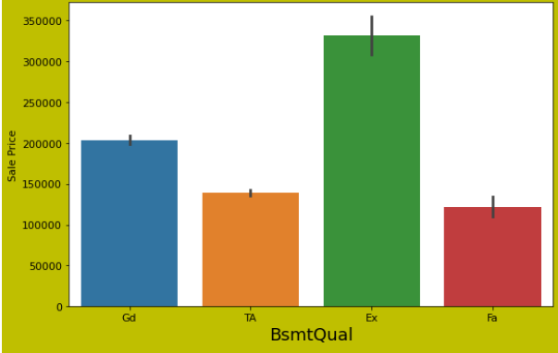
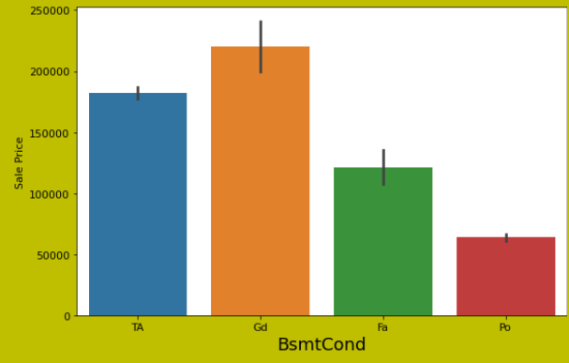
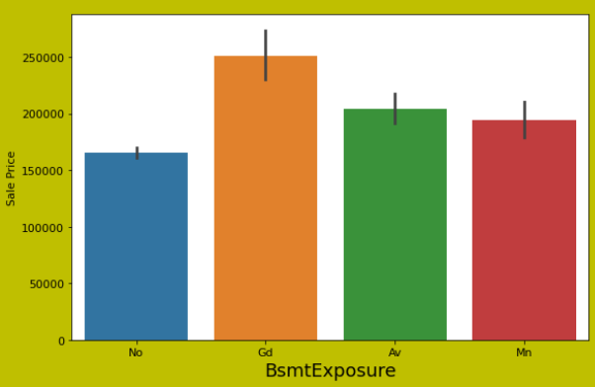
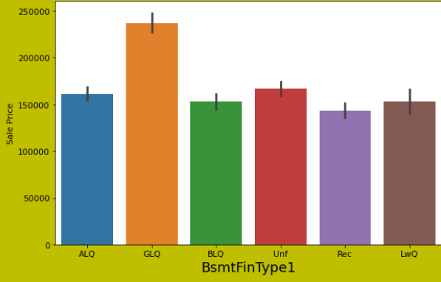
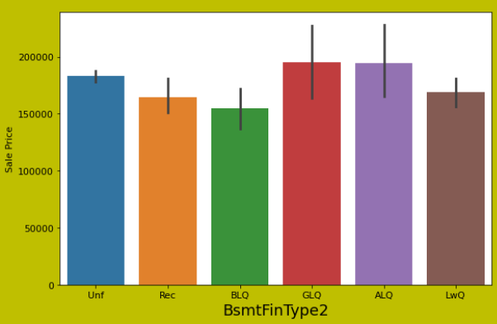

Slide 22
Observations
Maximum sale price is for Poured Concrete foundation properties.
Minimum sale price is for Slab foundation properties.
For Excellent basement quality sale price is maximum.
The lowest sale price is for fair basement quality.
The sale price is maximum for good basement condition.
Sale price is maximum for good basement exposure.

Slide 23
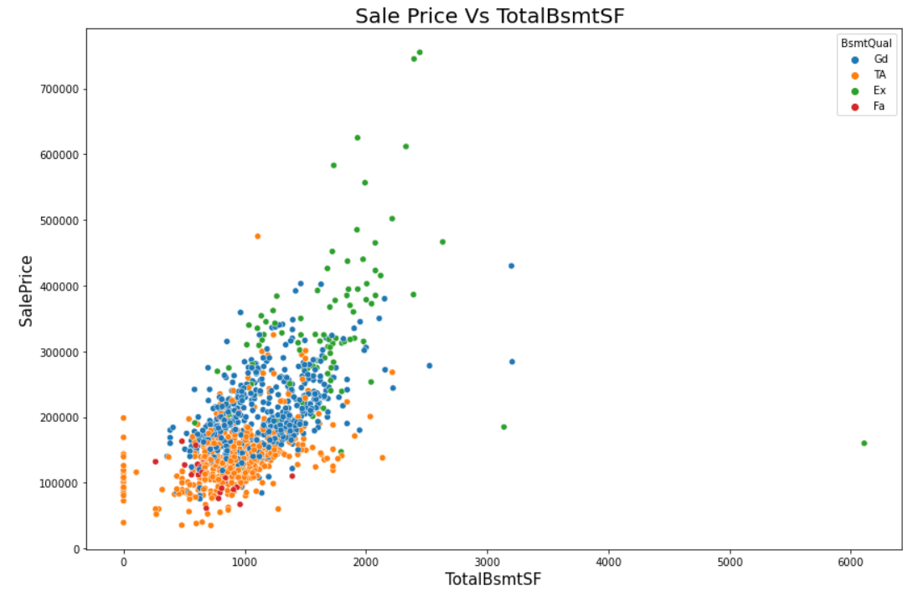
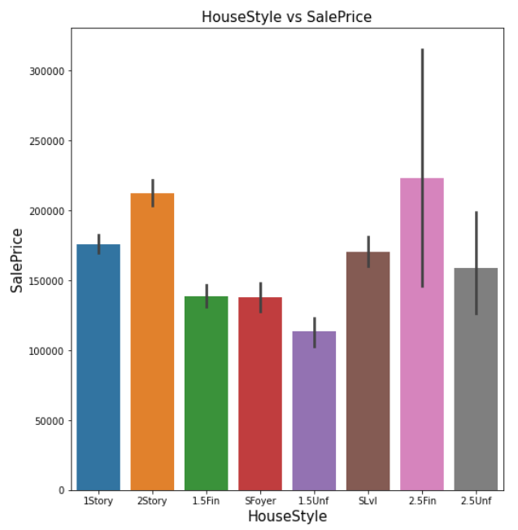
TotalBsmtSF & HouseStyle

Slide 24
Observations
As basement SF increases in relation to basement quality the sale price also increases.
The sale price is maximum for 2.5 Fin House style followed by 2Story.
The sale price is minimum for 1.5 Unf House style.

Slide 25
Machine Learning Algorithms Used
Following are the Machine learning algorithms used in this project
Linear Regression
Random Forest Regressor
Decision Tree Regressor
XGB Regressor
Extra Tree Regressor

Slide 26
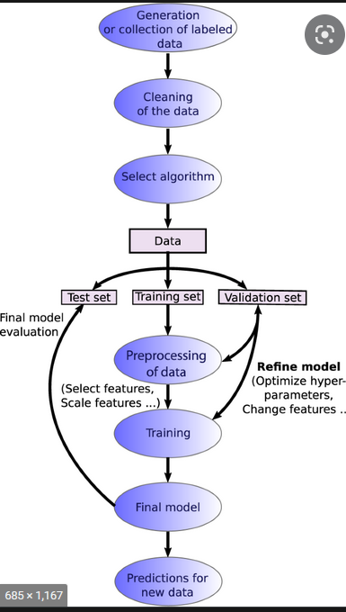
ML model building process flowchart

Slide 27
Values of R2 Score & CV Score with different algorithms
Sr.No. | Algorithm | R2 Score | CV Score
1 | Linear Regression | 0.879524 | 0.766207
2 | Random Forest Regressor | 0.910212 | 0.830423
3 | Decision Tree Regressor | 0.737304 | 0.694417
4 | XGB Regressor | 0.876909 | 0.820594
5 | Extra Tree Regressor | 0.901717 | 0.832681

Slide 28
Final Model
Since the Random forest regressor gives us better R2 Score with minimum difference between R2 Score & CV Score, we selected this as final model and hyperparameter optimization is done on this model.
After hyperparameter optimization the R2 Score is 0.936.
There is very low difference between Previously predicted R2 score and Predicted with Hyperparameters which is the best practice.

Slide 29
Important Variables for House Price Prediction
1. Overall Quality
2. GrLivArea
3. GarageCars
4. GarageArea
5. TotalbsmtSF
6. FullBath
7. TotRmsAbvGrd
8. MasVnrArea
9. Fireplaces
10. OpenPorchSF
11. LotFrontage
12. WoodDeckSF
13. HalfBath
14. LotArea
15. year_sincebuilt
16. year_RemodAdd
17. Garage_age
18. KitchenAbvGr
19. BsmtFullBath
20. BedroomAbvGr

Slide 30


